Slide 1
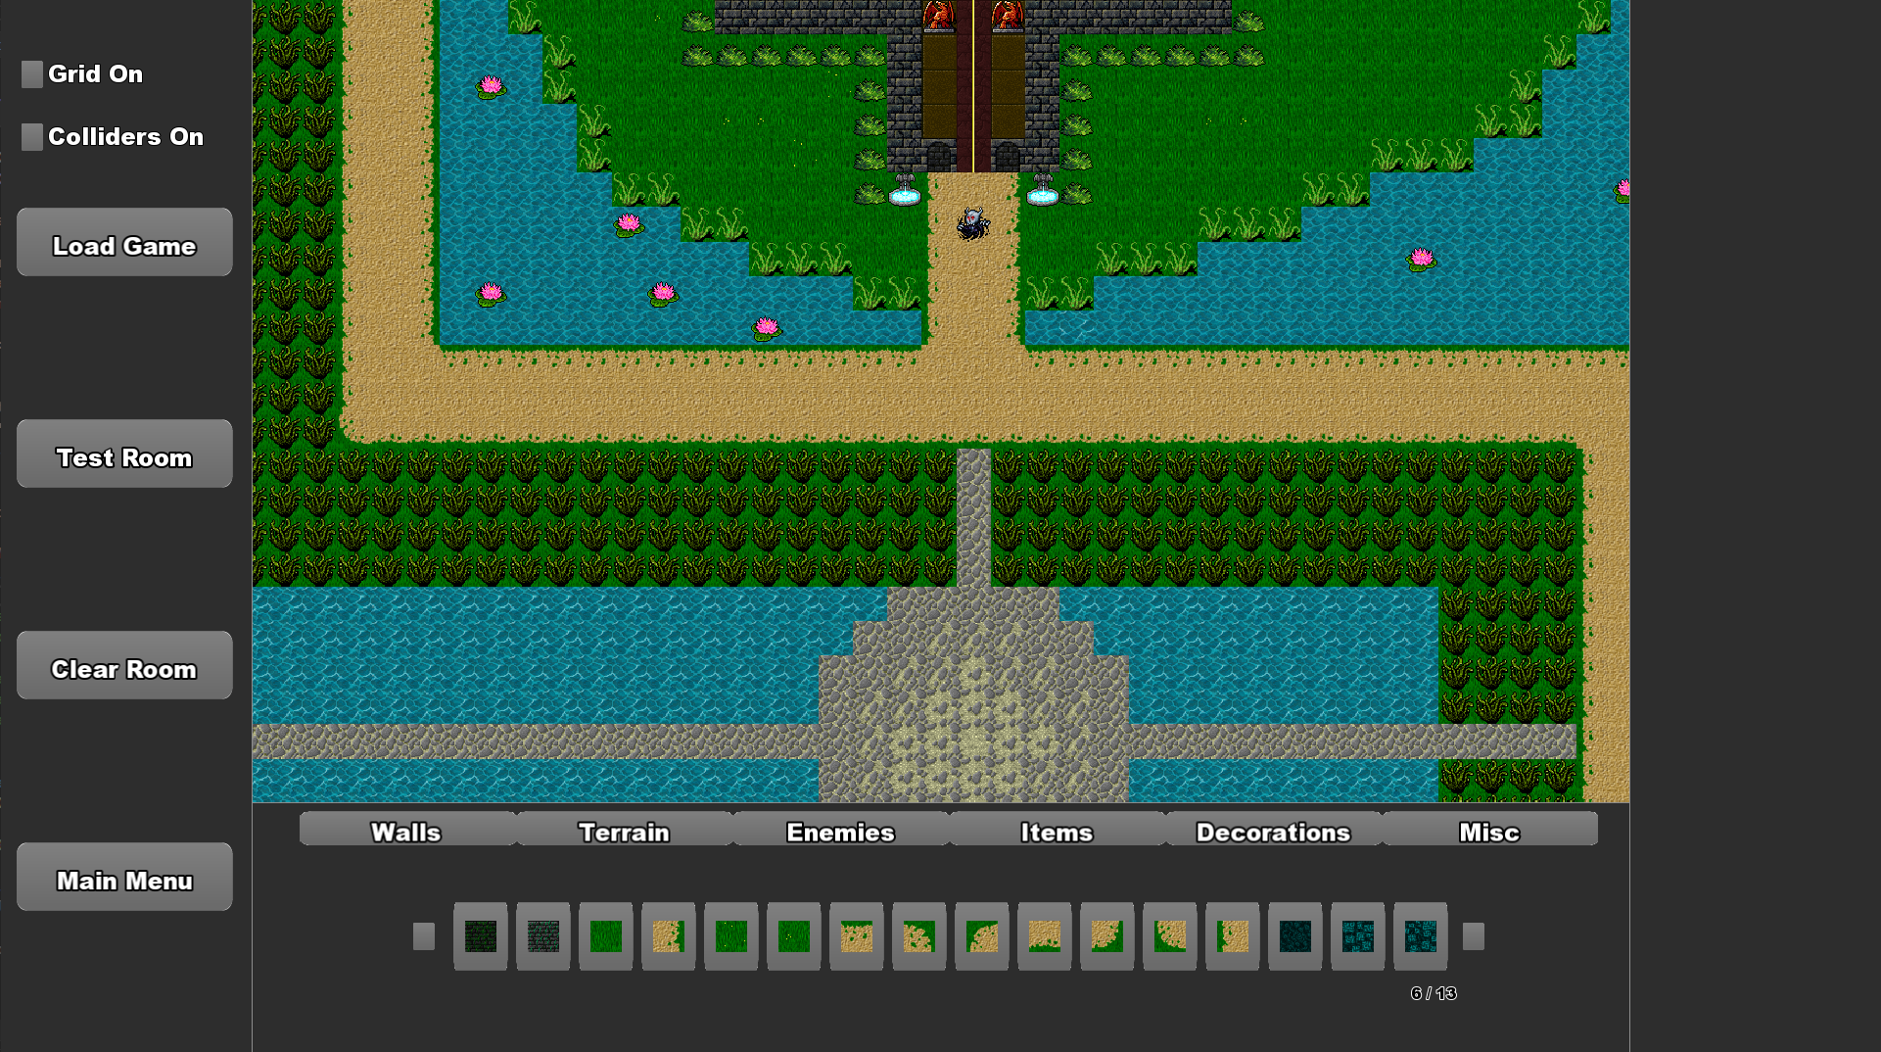
No Code Game Editor
"Meet Your Maker" is a No-Code Game Editor that aims to introduce non-technical users to the process of Game Design and Development, through its simple user interface and pre-programmed components.
The editor features a range of components created using C++ and SFML, that accommodates user designed game layouts, testing and playthroughs.
The user can save their build data using YAML throughout the creation process and load their game for further editing at a later time.

